Slide 1
Binomial heap
Programming Domain

Slide 2
What is a Binomial HEAP?
A Binomial Heap is a collection of Binomial Trees
Notes:
Insert a map of your country.

Slide 3
What is a Binomial Tree?
A Binomial Tree B_{k} is an ordered tree
A Binomial Tree of order 0 has 1 node.
B₀ -----→. 0
A Binomial Tree of order k can be constructed by taking two binomial trees of order k-1 and making one as leftmost child or other.
Notes:
Insert a map of your country.

Slide 4
0 B₀
0 + 0 ---→ B₁
+ ->
+ → B₃
Notes:
Insert a map of your country.

Slide 5
Properties OF BINOMIAL TREE
It has exactly 2^{k} nodes.
Degree of root is K
Height =K
There are exactly ^{k}c_{i} nodes at depth i , where
^{K}c_{i =} k! / (k- i !) (i)
Notes:
Insert a map of your country.

Slide 6
Binomial Heap
A binomial heap H is a set of binomial trees.
Each binomial tree in H is heap-ordered. So the key of a node is greater than or equal to the key of its parent.
There is at most one binomial tree in H, whose root has a given degree.
Notes:
Insert a map of your country.

Slide 7
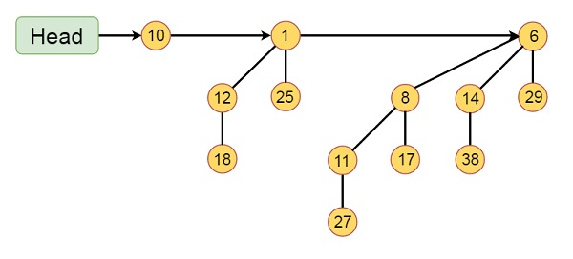
Example
This binomial Heap H consists of binomial trees B0, B2 and B3. Which have 1, 4 and 8 nodes respectively. And in total n = 13 nodes. The root of binomial trees are linked by a linked list in order of increasing degree
Notes:
Insert a map of your country.

Slide 8
Union or Merging of two binomial heap
Merging in a heap can be done by comparing the keys at the roots of two trees, and the root node with the larger key will become the child of the root with a smaller key than the other.
Notes:
Insert a map of your country.

Slide 9
Cases for merging/union
Case 1: If degree[x] is not equal to degree[next x], then move pointer ahead.
Case 2: if degree[x] = degree[next x] = degree[sibling(next x)] then, Move the pointer ahead.
Case 3: If degree[x] = degree[next x] but not equal to degree[sibling[next x]] and key[x] < key[next x] then remove [next x] from root and attached to x.
Notes:
Insert a map of your country.

Slide 10
Case 4: If degree[x] = degree[next x] but not equal to degree[sibling[next x]] and key[x] > key[next x] then remove x from root and attached to [next x]
Notes:
Insert a map of your country.

Slide 11
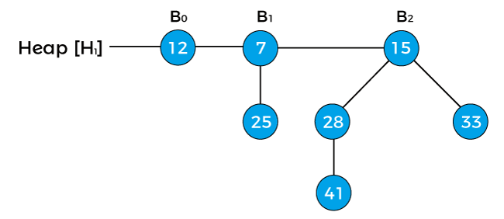
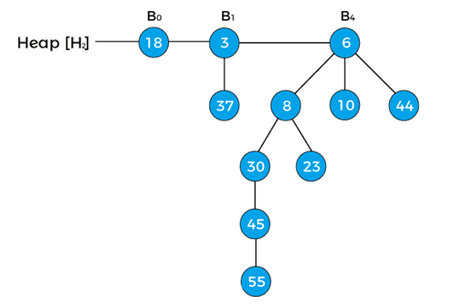
Notes:
Insert a map of your country.

Slide 12
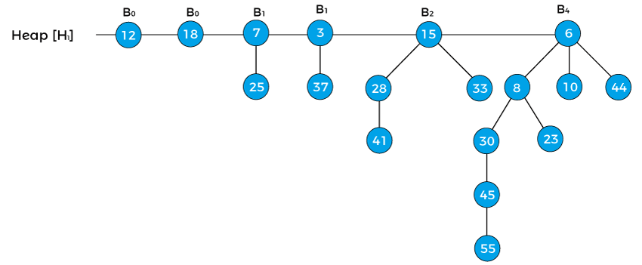
To combine the heaps, first, we need to arrange their binomial trees in increasing order.
Notes:
Insert a map of your country.

Slide 13
In the heap first, the pointer x points to the node 12 with degree B₀,
the pointer next[x] points the node 18 with degree B₀.
Node 7 with degree B₁ is the sibling of 18, therefore, it is represented as sibling[next[x]].
Notes:
Insert a map of your country.

Slide 14
Now, first apply Case1 that says 'if degree[x] ≠ degree[next x] then move pointer ahead' but here, the degree[x] = degree[next[x]], so this case is not valid.
Notes:
Insert a map of your country.

Slide 15
Now, apply Case2 that says 'if degree[x] = degree[next x] = degree[sibling(next x)] then Move pointer ahead'. So, this case is also not applied
Notes:
Insert a map of your country.

Slide 16
Now, apply Case3 that says ' If degree[x] = degree[next x] ≠ degree[sibling[next x]] and key[x] < key[next x] then remove [next x] from root and attached to x'.
Notes:
Insert a map of your country.

Slide 17
We will apply this case because the above heap follows the conditions of case 3 –
degree[x] = degree[next x] ≠ degree[sibling[next x]] {as, B₀ = B₀¬ ≠ B₁} and key[x] < key[next x] {as 12 < 18}.
Notes:
Insert a map of your country.

Slide 18
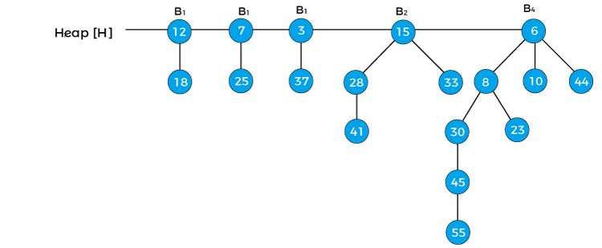
So, remove the node 18 and attach it to 12
x = 12, next[x] = 7, sibling[next[x]] = 3, and degree[x] = B₁, dgree[next[x]] = B₁, degree[sibling[next[x]]] = B₁
Notes:
Insert a map of your country.

Slide 19
Now we will reapply the cases in the binomial heap. First, we will apply case 1. Since x is pointing to node 12 and next[x] is pointing to node 7, the degree of x is equal to the degree of next x; therefore, case 1 is not valid.
Notes:
Insert a map of your country.

Slide 20
Here, case 2 is valid as the degree of x, next[x], and sibling[next[x]] is equal. Here, case 2 is valid as the degree of x, next[x], and sibling[next[x]] is equal.
Notes:
Insert a map of your country.

Slide 21
So, according to the case, we have to move the pointer ahead. Therefore, x = 7, next[x] = 3, sibling[next[x]] = 15, degree[x] = B₁, degree[next[x]] = B₁, degree[sibling[next[x]]] = B₂
Notes:
Insert a map of your country.

Slide 22
apply case 3, here, first condition of case3 is satisfied as degree[x] = degree[next[x]] ≠ degree[sibling[next[x]]], but second condition (key[x] < key[next x]) of case 3 is not satisfied.
Notes:
Insert a map of your country.

Slide 23
apply case 4. So, first condition of case4 is satisfied and second condition (key[x] > key[next x]) is also satisfied. Therefore, remove x from the root and attach it to [next[x]].
Notes:
Insert a map of your country.

Slide 24
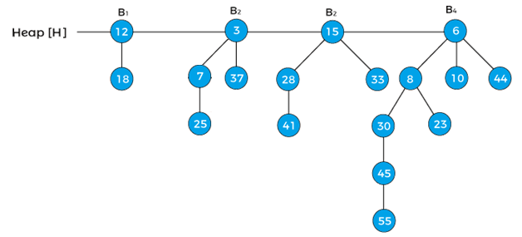
Notes:
Insert a map of your country.

Slide 25
Now, the pointer x points to node 3,
next[x] points to node 15,
sibling[next[x]] points to the node 6.
Since, the degree of x is equal to the degree of next[x] but not equal to the degree[sibling[next[x]]], and the key value of x is less than the key value of next[x], so we have to remove next[x] and attach it to x
Notes:
Insert a map of your country.

Slide 26
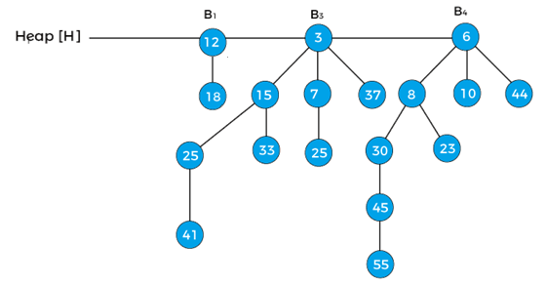
Notes:
Insert a map of your country.

Slide 27
Now, x represents to the node 3, and next[x] points to node 6. Since, the degree of x and next[x] is not equal, so case1 is valid. Therefore, move the pointer ahead. Now, the pointer x points the node 6.
The B4 is the last binomial tree in a heap, so it leads to the termination of the loop. The tree is the final tree after the union of two binomial heaps.
Notes:
Insert a map of your country.

Slide 28
Insert an element in the heap
Inserting an element in the heap can be done by simply creating a new heap only with the element to be inserted, and then merging it with the original heap
Notes:
Insert a map of your country.

Slide 29
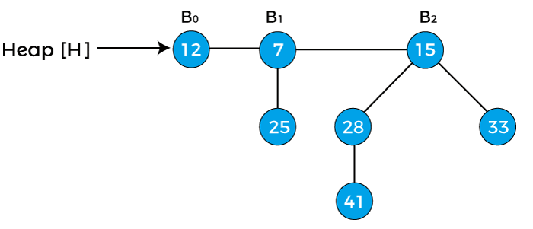

there are three binomial trees of degrees 0, 1, and 2 are given where B0 is attached to the head of the heap.
Suppose we have to insert node 15 in the heap.
Notes:
Insert a map of your country.

Slide 30
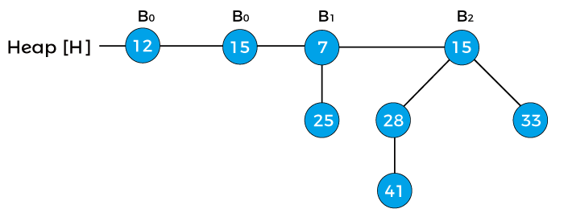
First, we have to combine both of the heaps.
As both node 12 and node 15 are of degree 0, so node 15 is attached to node 12 as shown below
Notes:
Insert a map of your country.

Slide 31
Now, assign x to B₀ with value 12, next(x) to B₀ with value 15, and assign sibling(next(x)) to B₁ with value 7.
As the degree of x and next(x) is equal.
The key value of x is smaller than the key value of next(x), so next(x) is removed and attached to the x.
Notes:
Insert a map of your country.

Slide 32
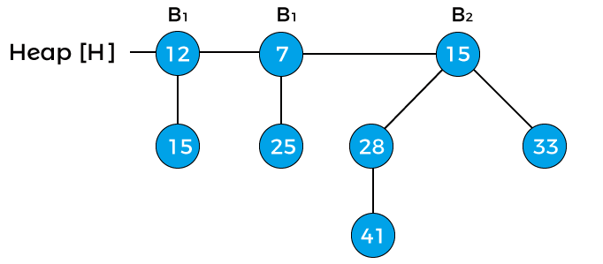
Notes:
Insert a map of your country.

Slide 33
Now, x points to node 12 with degree B₁, next(x) to node 7 with degree B₁, and sibling(next(x)) points to node 15 with degree B₂.
The degree of x is equal to the degree of next(x) but not equal to the degree of sibling(next(x)).
The key value of x is greater than the key value of next(x); therefore, x is removed and attached to the next(x)
Notes:
Insert a map of your country.

Slide 34
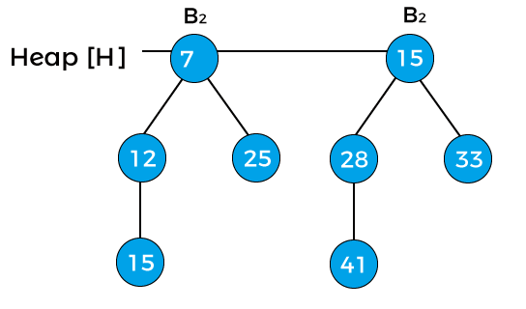
Notes:
Insert a map of your country.

Slide 35
Now, x points to node 7, and next(x) points to node 15.
The degree of both x and next(x) is B₂, and the key value of x is less than the key value of next(x), so next(x) will be removed and attached to x
Notes:
Insert a map of your country.

Slide 36
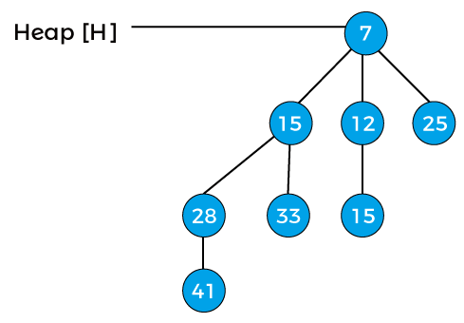
Now, the degree of the heap is B₃, and it is the final binomial heap after inserting node 15.
Notes:
Insert a map of your country.

Slide 37
Extracting the minimum key
It means that we have to remove an element with the minimum key value.
As we know, in min-heap, the root element contains the minimum key value.
So, we have to compare the key value of the root node of all the binomial trees.
Notes:
Insert a map of your country.

Slide 38
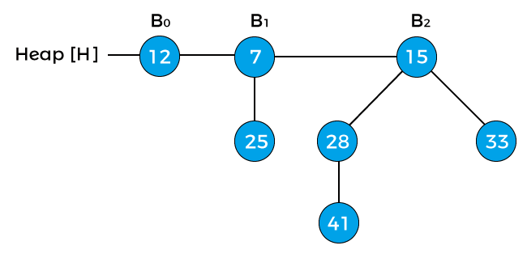
Notes:
Insert a map of your country.

Slide 39
Compare the key values of the root node of the binomial trees in the heap.
So, 12, 7, and 15 are the key values of the root node in the above heap in which 7 is minimum; therefore, remove node 7 from the tree
Notes:
Insert a map of your country.

Slide 40
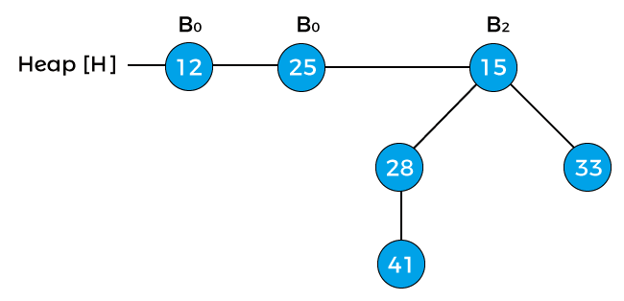
Notes:
Insert a map of your country.

Slide 41
the degree of node 12 and node 25 is B₀, and the degree of node 15 is B₂.
Pointer x points to the node 12, next(x) points to the node 25, and sibling(next(x)) points to the node 15.
Since the degree of x is equal to the degree of next(x) but not equal to the degree of sibling(next(x)).
Value of pointer x is less than the pointer next(x), so node 25 will be removed and attached to node 12
Notes:
Insert a map of your country.

Slide 42
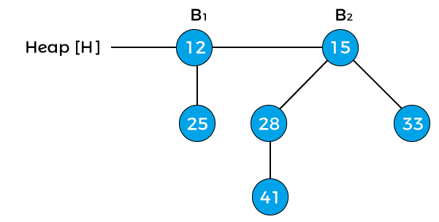
Now, the degree of node 12 is changed to B₁.
The heap is the final heap after extracting the minimum key.
Notes:
Insert a map of your country.

Slide 43

Deleting a node from the heap
To delete a node from the heap, first, we have to decrease its key to negative infinity (or -∞) and then delete the minimum in the heap
node 41 from the heap -
Notes:
Insert a map of your country.

Slide 44

First, replace the node with negative infinity (or -∞)
Now, swap the negative infinity with its root node in order to maintain the min-heap property.
Notes:
Insert a map of your country.

Slide 45

again swap the negative infinity with its root node
Notes:
Insert a map of your country.

Slide 46

The next step is to extract the minimum key from the heap. Since the minimum key in the above heap is -infinity so we will extract this key, and the heap would be:
Notes:
Insert a map of your country.

Slide 47
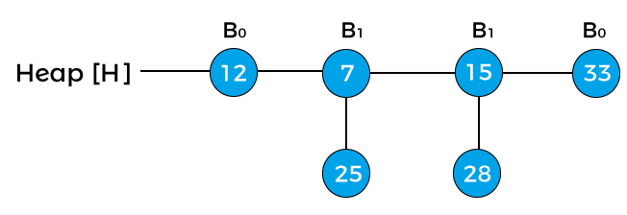
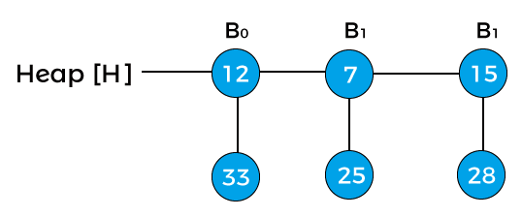
Notes:
Insert a map of your country.

Slide 48
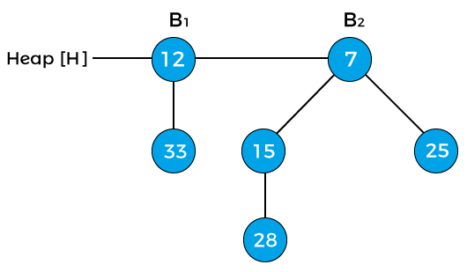
Notes:
Insert a map of your country.

